Slide 1






CELL DESIGNER

Slide 2
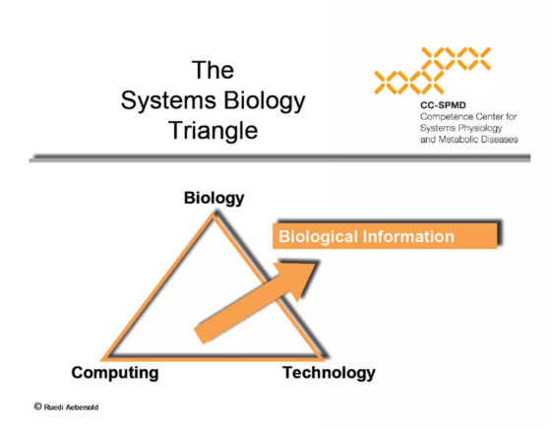
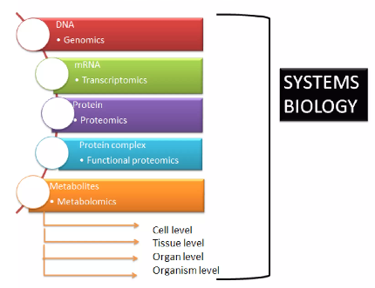


Overview
Introduction to cell designer
What kind of model we can build
SBML (Systems Biology Markup Language)
SBGN (Systems Biology Graphical Notation)
A. Funahashi, M. Morohashi, H. Kitano, and N. Tanimura, “CellDesigner: a process diagram editor for gene-regulatory and biochemical networks,” BIOSILICO, vol. 1, pp. 159–162, Nov. 2003, doi: 10.1016/s1478-5382(03)02370-

Slide 3
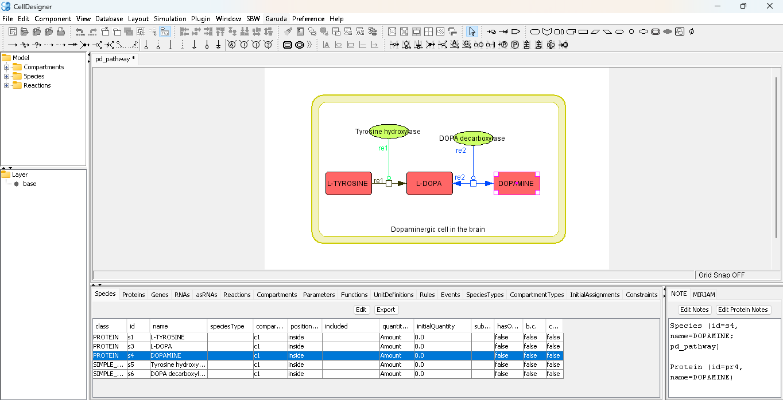
How to build a pathway with a Cell designer
Pathway map
Mathematical model

Slide 4
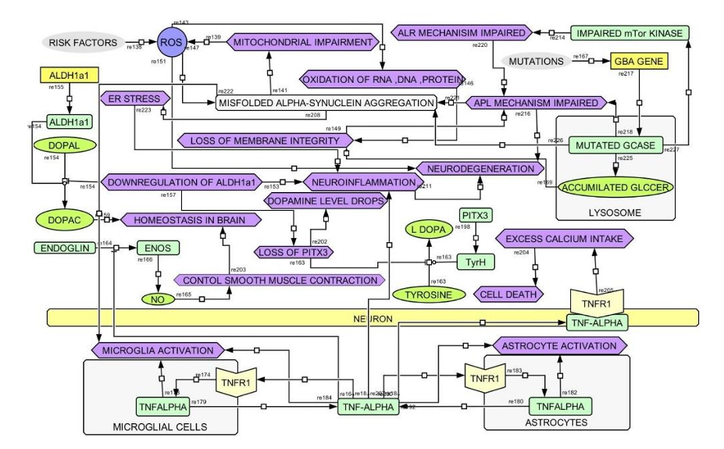
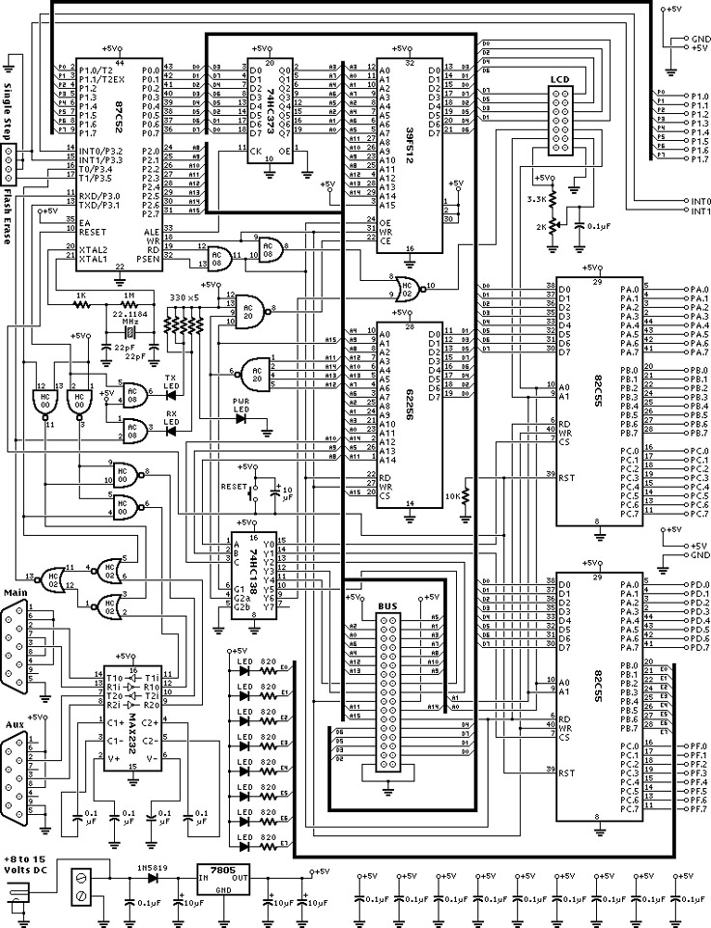
Comprehensive Pathway Map
Cellular information compared with electronic circuit diagram

Slide 5
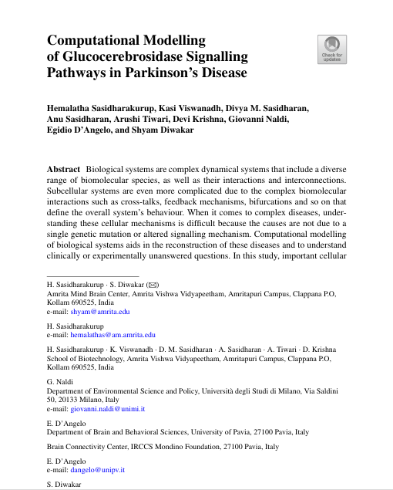
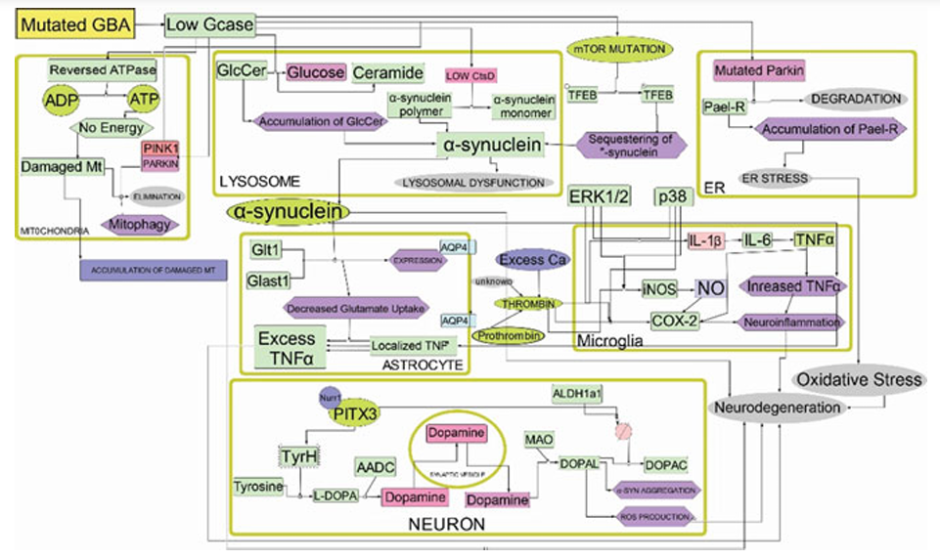
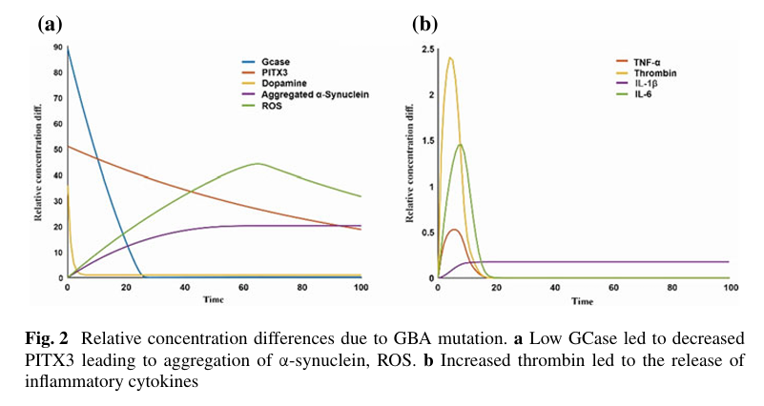
Mathematical Model
Springer Nature 2023

Slide 6
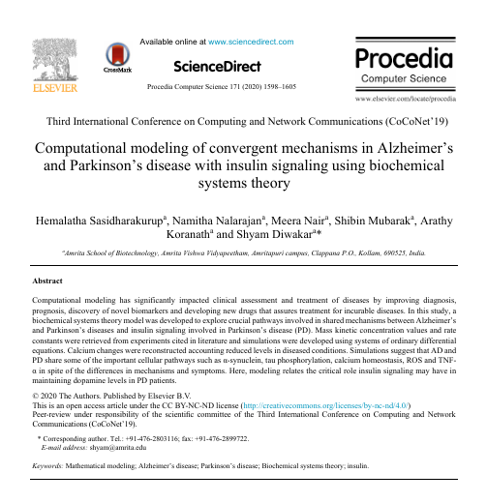
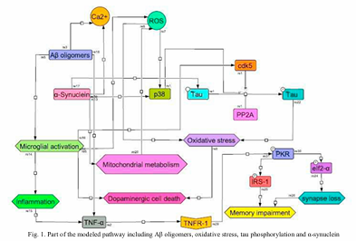
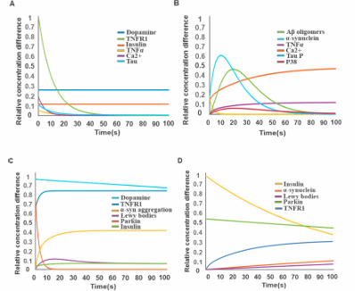
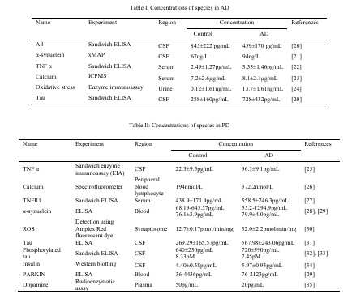
Elsevier 2020

Slide 7
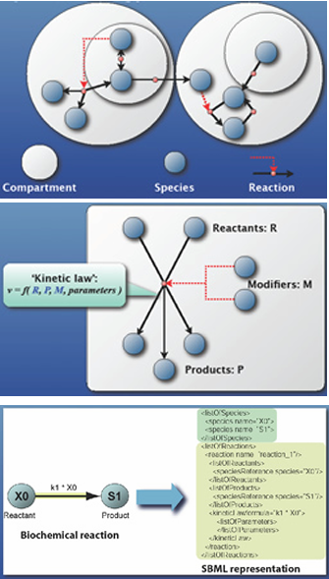
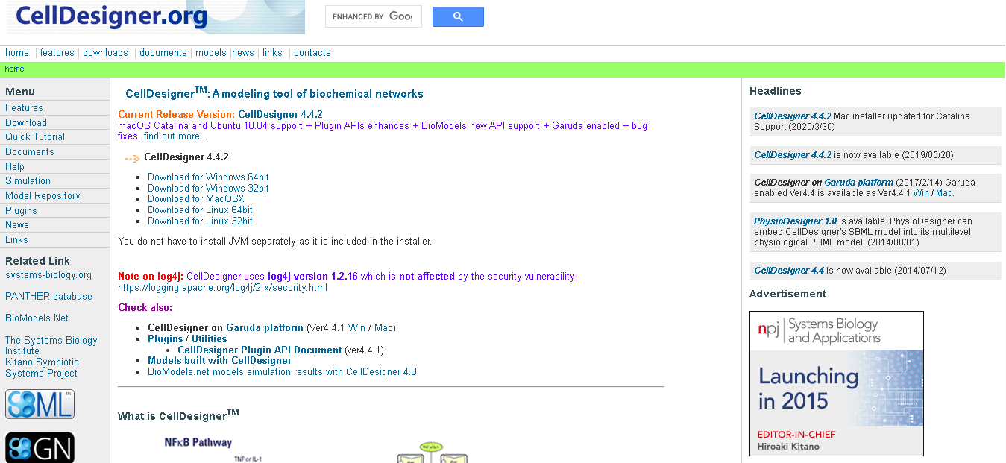
Cell Designer Interface
https://www.celldesigner.org/

Slide 8
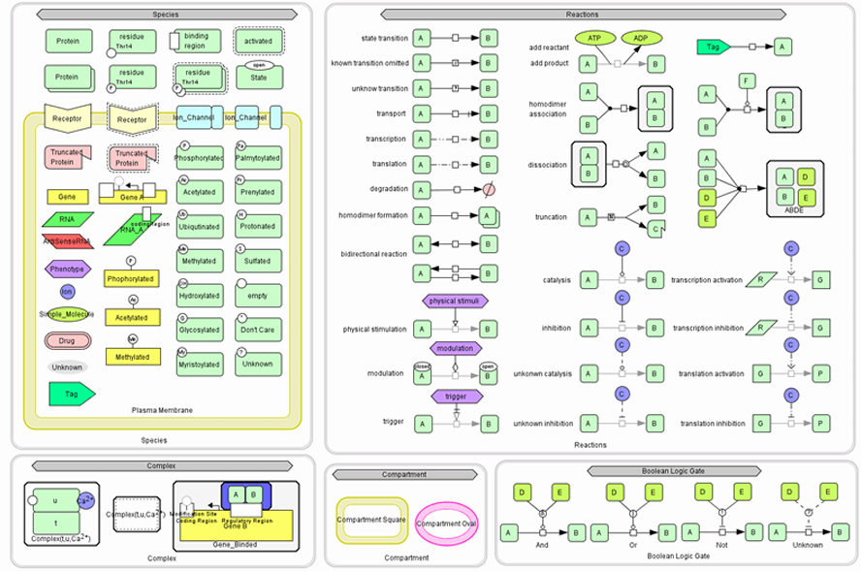
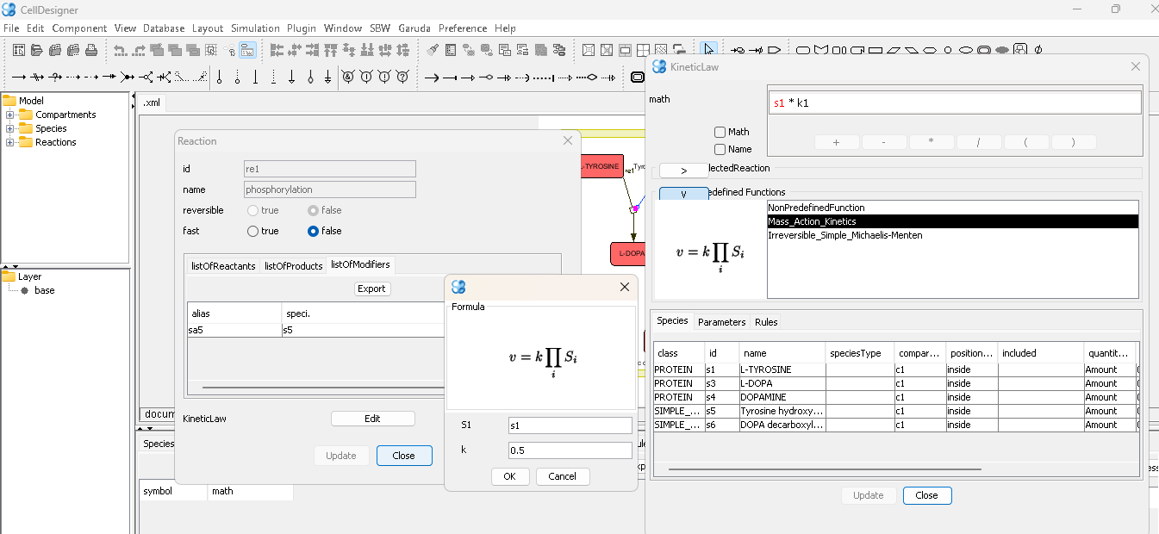
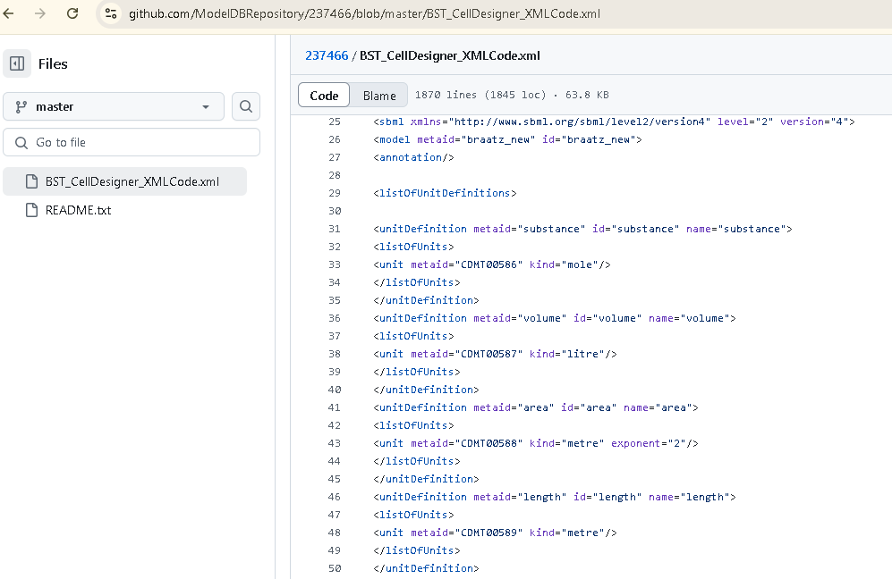
SBGN & SBML

Slide 9
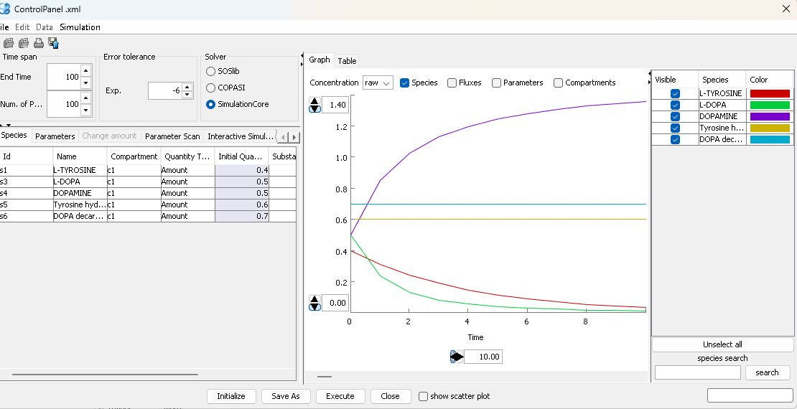
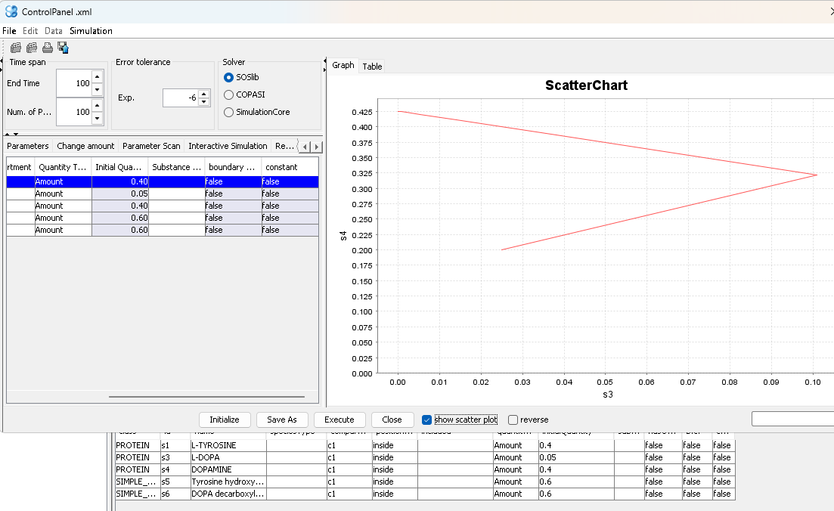
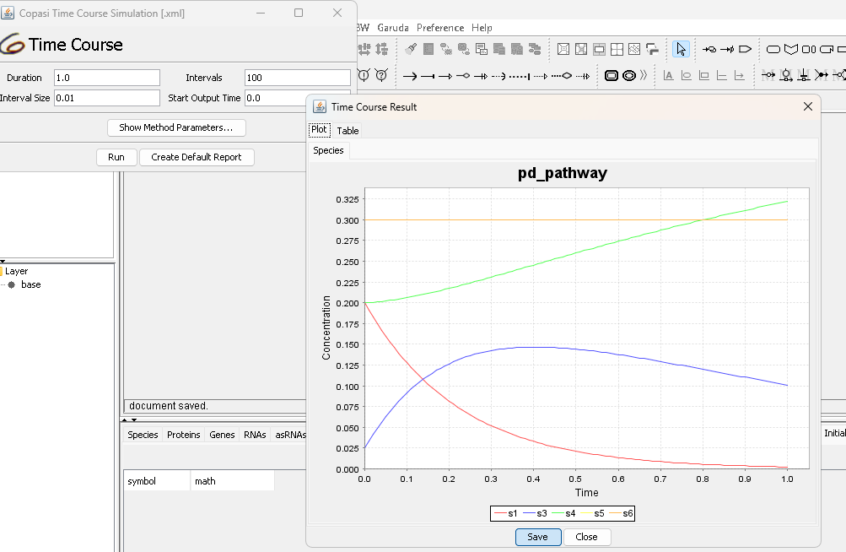
Simulation Model

Slide 10
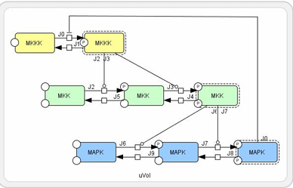
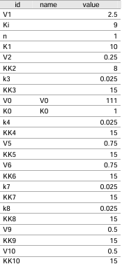
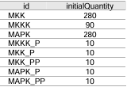
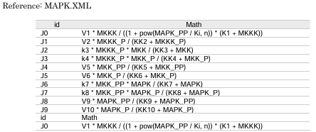
Simulation Parameters

Slide 11
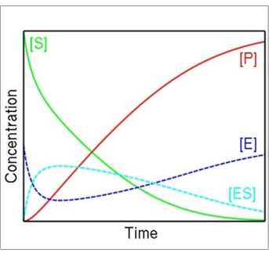
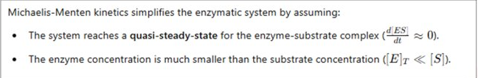
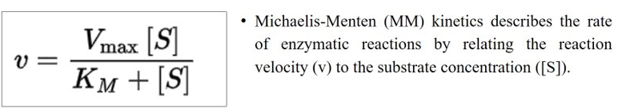
MM Kinetic Equation
The math behind
Michaelis-Menton (MM) kinetics – the rate of enzymatic reactions by relating the reaction velocity (v) to the substrate concentration [s]

Slide 12
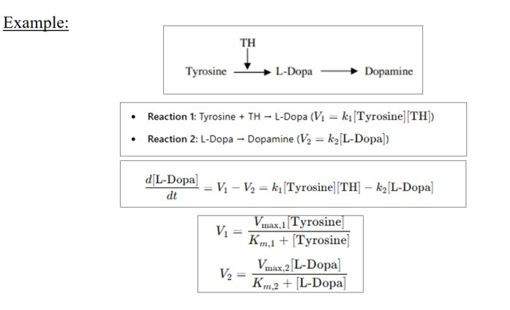
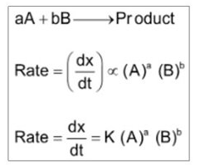
Law of Mass Action
Rate of the chemical reactions is directly proportional to the product of the activities or concentrations of the reactants

Slide 13
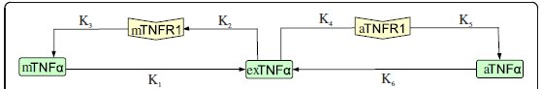
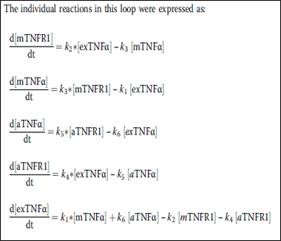
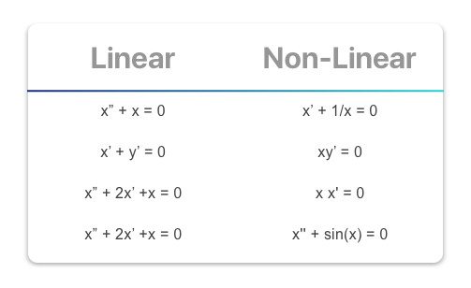
ORDINARY DIFFERENTIAL EQUATION
ODE defined for one or more functions of one independent variable and its derivatives
Linear Equation
Non - Linear Equation

Slide 14

Parkinson’s Disease
E.g.: Case study model
Neurological disorder.
The protein can misfold and form clumps called aggregates. These aggregates are toxic to nerve cells.
Normal Pathway: In a healthy state, α-synuclein plays a role in synaptic function and neurotransmitter release.
Diseased Pathway: Mutations in the SNCA gene lead to the accumulation of misfolded α-synuclein, resulting in aggregation.

Slide 15
Alpha-Synuclein: From Cellular Function to Parkinson's Disease
Alpha-synuclein: Small protein abundant in presynaptic terminals of neurons.
Predominantly found in the brain, with smaller amounts in other tissues like the heart and muscles.
The gene of interest for alpha-synuclein is indeed the SNCA gene, provides instructions for making alpha-synuclein
Part of the synuclein family, distinguished by unique structure and function.
Implicated in various neurodegenerative diseases like Parkinson's, dementia with Lewy bodies, and multiple system atrophy.

Slide 16
Pathway of Alpha-Synuclein in a healthy individual:
Role 1: Supporting Neurotransmitter Release
mRNA transcribed from SNCA gene
Translation in ribosome, localised alpha synuclein in neural terminals
Alpha synuclein regulates synaptic vesicles release
Clustering of synaptic vesicles → efficient release of neurotransmitters

Slide 17
Pathway of Alpha-Synuclein in a healthy individual:
Role 2: Maintaining Synaptic Vesicle Supply
Alpha synuclein bind to lipid membranes
Maintain synaptic vesicle supply
Role 3: Degradation of Misfolded or Excess Alpha-Synuclein
Misfolded/excess alpha synuclein tagged with ubiquitin
Degraded by proteosome and some via autophagy lysosomal pathway

Slide 18
Pathway of Alpha-Synuclein in a Diseased individual:
Overproduction of alpha-synuclein
Chaperone proteins fail due to overabundance
Spontaneous aggregation of misfolded alpha-synuclein in neurons
Misfolded alpha-synuclein: toxic to neurons

Slide 19
Pathway of Alpha-Synuclein in a Diseased Individual (cont’d):
Activates apoptotic pathways: Neuronal cell death
TLR(Toll like receptors) activate inflammatory signalling pathways
Neurodegeneration
Release of pro-inflammatory cytokines: chronic inflammation

Slide 20
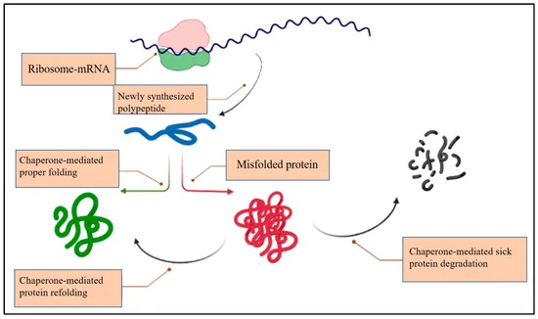
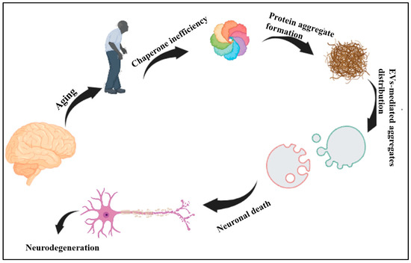
Pathway of Alpha-Synuclein in a healthy vs diseased individual:
X. Dong-Chen, C. Yong, X. Yang, S. T. Chen-Yu, and P. Li-Hua, “Signaling pathways in Parkinson’s disease: molecular mechanisms and therapeutic interventions,” Signal Transduction and Targeted Therapy 2023 8:1, vol. 8, no. 1, pp. 1–18, Feb. 2023, doi: 10.1038/s41392-023-01353-3.

Slide 21
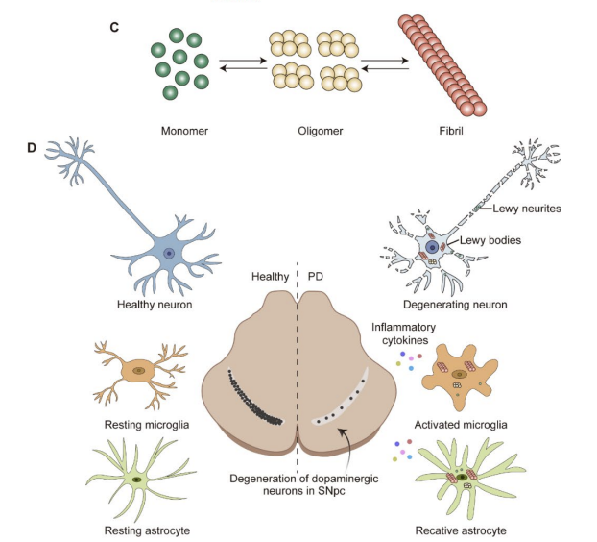
Progression of Alpha-synuclein

Slide 22
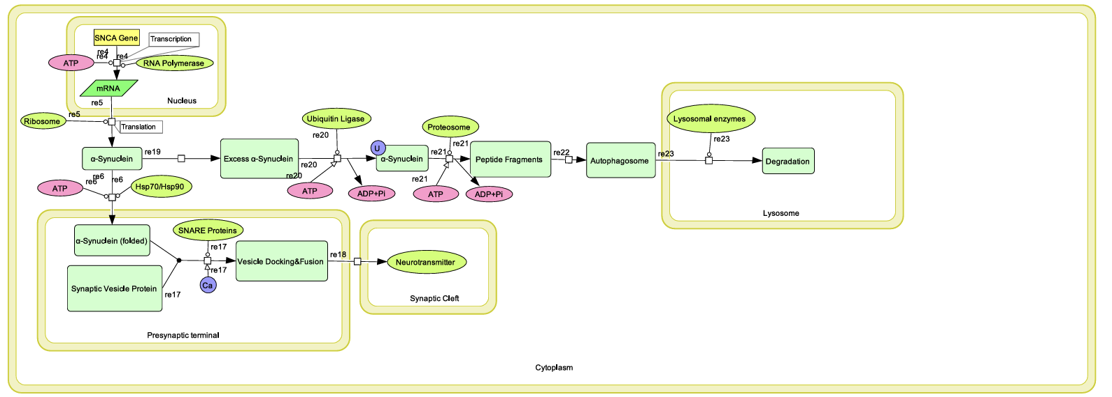
Normal pathway in healthy individual - CellDesigner
Y. Matsuoka, A. Funahashi, S. Ghosh, and H. Kitano, “Modeling and Simulation Using CellDesigner,” Methods in Molecular Biology, vol. 1164, pp. 121–145, 2014, doi: 10.1007/978-1-4939-0805-9_11.

Slide 23
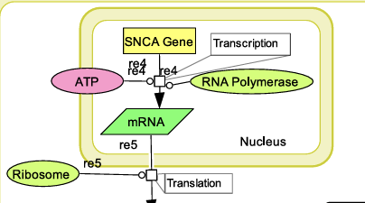

Slide 24
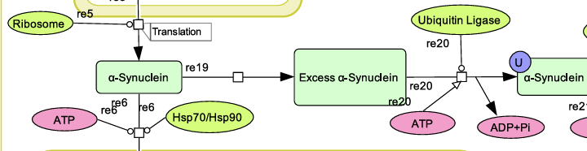

Slide 25
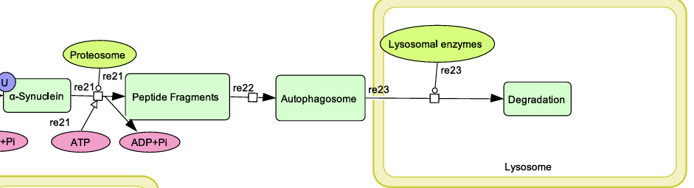

Slide 26
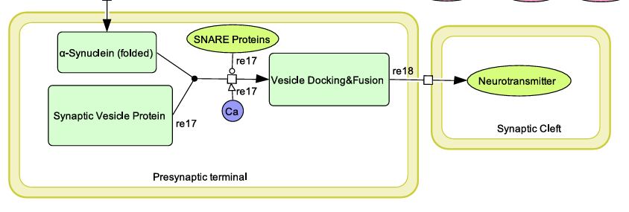

Slide 27
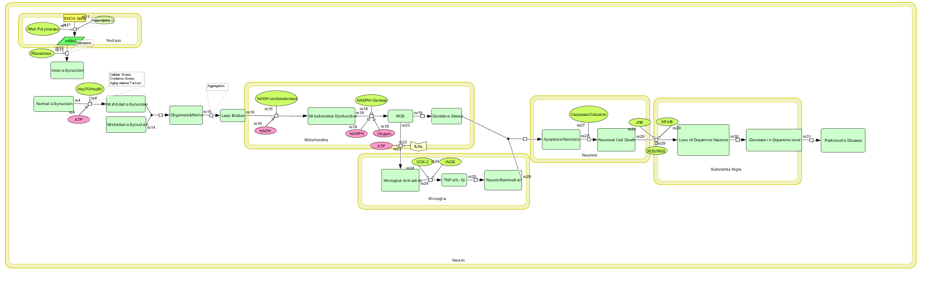
Diseased pathway in patients - CellDesigner

Slide 28
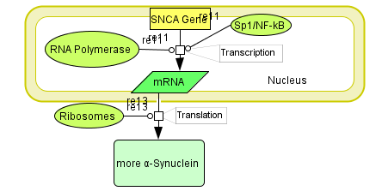

Slide 29
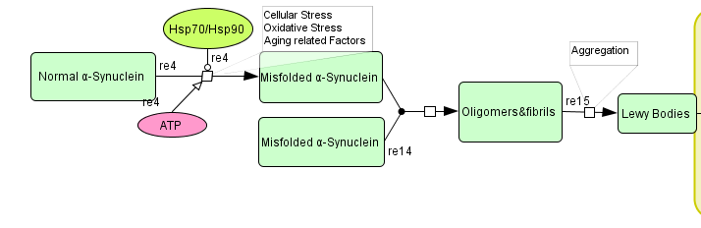

Slide 30
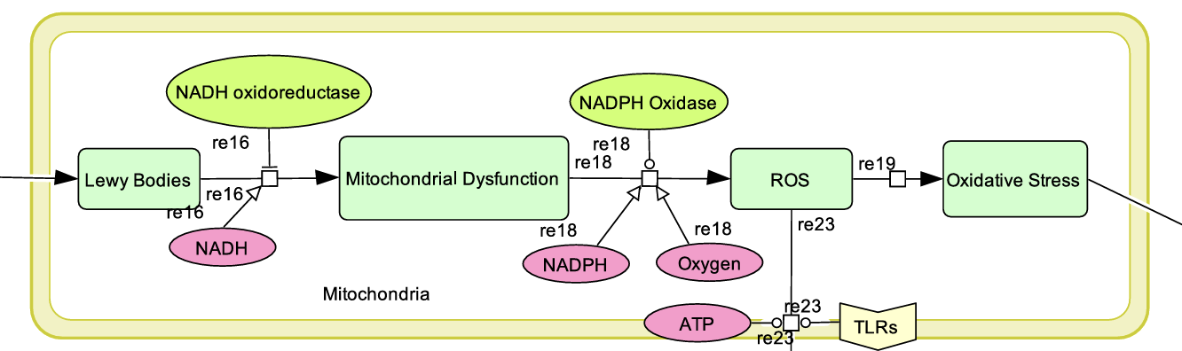

Slide 31
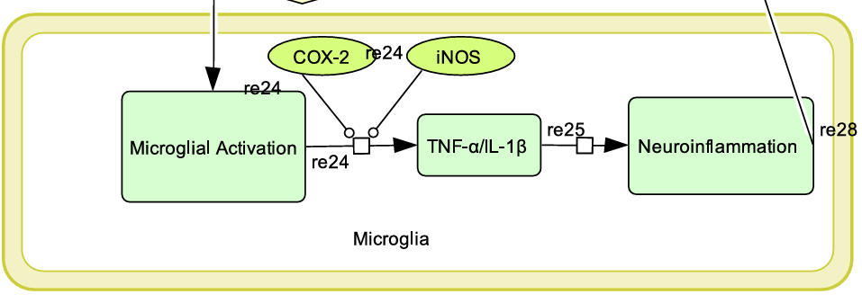

Slide 32
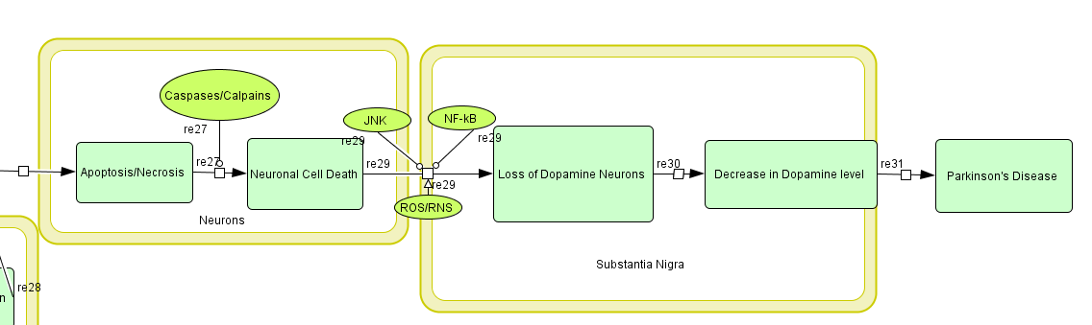

Slide 33
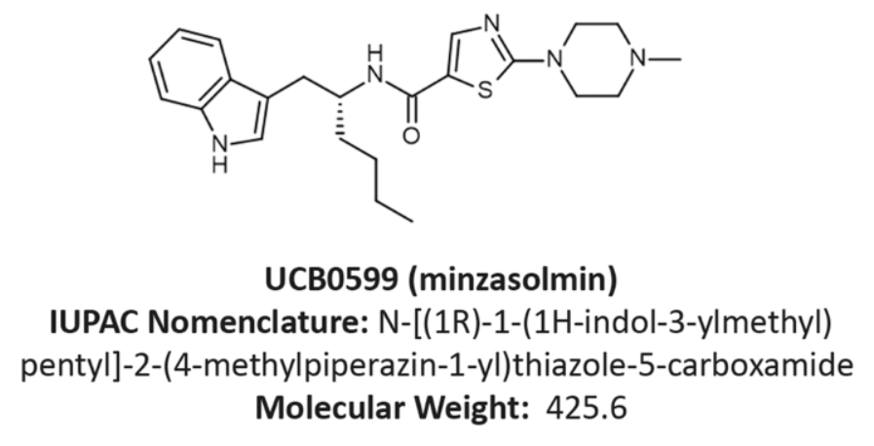
Drug: Minzasolmin
Small molecule asyn aggregation inhibitor
Licensed in 2014 by Neuropore
A series of cyclic peptidomimetic compounds interact with C terminal domain of asyn, prevent from binding to membranes and oligomerization.
Second generation compound, oral bioavailability and entry
Purified R enantiomer of the racemic mixture NPT-200-11.

Slide 34
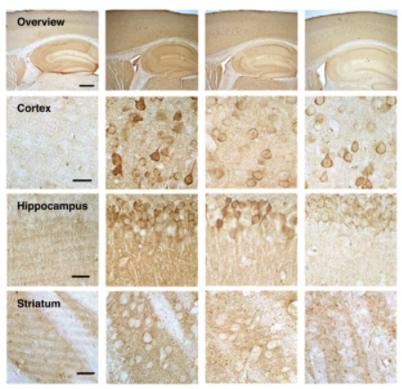
Reduced total ASYN pathology in line 61 transgenic mice
Reduced retinal asyn pathology, lessened cortical asyn pathology, normalised striatal DAT levels, and improved motor function

Slide 35
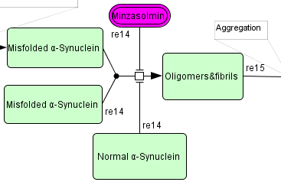
Minzasolmin operates at an early stage of the aggregation process by displacing membrane-bound oligomeric ASYN and converting it back to its monomeric form, thereby preventing the formation of larger ASYN aggregates and Lewy bodies.

Slide 36
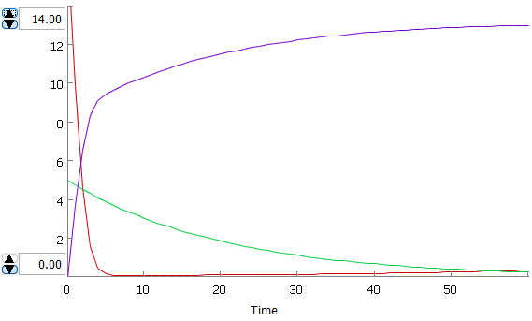
The score decreased to nil, while oligomers could only be formed at half the rate. They stabilize as no more proteins are misfolded, then reaccumulate.
OLIGOMER
DRUG
MISFOLDED
Composite scores were taken instead of concentration levels.
Initial concentration of drug: 5.0 mg
Initial score of misfolded alpha-synuclein: 16.8
Initial score of oligomers: 0.0

Slide 37
EXERCISE 1.0
Minzasolmin is introduced as a potential inhibitor of α-synuclein aggregation. Based on the reaction model provided, in Cell Designer, how would you represent the conversion of normal α-synuclein into misfolded α-synuclein and its subsequent aggregation into oligomers and fibrils? What reaction type would you use, and how would you define the inhibitory effect of Minzasolmin?
How would you represent the effect of Lewy Bodies on mitochondrial dysfunction and ROS generation in Cell Designer? Which reaction parameters would be crucial for simulating oxidative stress dynamics?
Using Cell Designer, how would you model the role of NADPH oxidase in ROS production? Which kinetic law would best represent ROS formation, and how could you introduce an antioxidant intervention in the model?

Slide 38
EXERCISE 2.0
Microglial activation leads to the production of inflammatory cytokines (TNF-α/IL-1β), which contribute to neuroinflammation.
In Cell Designer:
a) Modeling Interactions: How would you define the regulatory effect of COX-2 and iNOS on TNF-α/IL-1β production? Would you use mass-action kinetics or a different regulatory function?
b) Intervention Strategies: Suppose you introduce an anti-inflammatory drug that inhibits COX-2 activity. How would you modify the reaction parameters to reflect the drug's effect on TNF-α/IL-1β levels?

Slide 39
Thank You

